Slide 1


GIRA
Overview
Cleaning
Analysis
Dashboard
Page 01
ANALYTICS.
Station availability, 2020–2023
GIRA Network
Where the bike-share fails, and what EMEL should fix first
Data Analyst Project
TEAM
Rita Lima · Bruno Conceição · Cláudio Pitra · Erick Dos Santos
Prepared for EMEL · Operations & Rebalancing
Notes:
Opening. Four years of GIRA station data, 2020 to 2023 Q1, analysed for EMEL's operations team. State the through-line up front: the network does not fail on average, it fails at specific stations at specific hours, and geography explains most of it. Then walk the three sub-questions - WHEN, WHERE, WHAT to do.

Slide 2






GIRA
Overview
Cleaning
Analysis
Dashboard
Page 02
ANALYTICS.
BACKGROUND
From a 100-bike pilot to a city-wide network
2017: the pilot
GIRA TODAY
EMEL launched GIRA in Parque das Nações: 100 bikes, 10 stations, 1,600 volunteer testers before going public.
147
Built for the hills
stations by 2023 Q1, up from 85
Electric-assist bikes were part of the design from the start. Lisbon's topography made them essential, and it still shapes where stations fail.
10M+
Citywide growth
The docked network expanded from the riverside outward, station by station, across the years this project studies.
trips since the 2017 launch
A proven habit
1,700+
GIRA passed 10 million trips by 2023. Every empty dock in this data has a real rider behind it.
bikes, regular and electric-assist
Notes:
GIRA started in June 2017 as a pilot in Parque das Nacoes: 100 bikes, 10 stations, 1,600 volunteer beta testers, run by EMEL, the municipal mobility company. Two points to land: electric-assist was designed in from the start because of the hills - that foreshadows our SQ2 finding; and by 2023 GIRA had passed 10 million trips, so this is a real habit, not a novelty.

Slide 3




GIRA
Overview
Cleaning
Analysis
Dashboard
Page 03
ANALYTICS.
THE BUSINESS QUESTION
Riders keep finding stations empty or full
Riders arrive to find no bike, or no free dock, and EMEL cannot tell which stations at which hours need bikes moved first.
The operational problem, in one sentence
MAIN QUESTION
Where and when does the GIRA network fail its users, and how should EMEL prioritize rebalancing and expansion?
SQ1 · WHEN
SQ2 · WHERE
SQ3 · WHAT
Failure rates by hour, weekday vs weekend, and month.
Which stations fail, and does Lisbon's geography explain it?
Rebalancing priorities, van loops, and whether expansion aimed right.
Notes:
This is the client framing. The stakeholder for this project is EMEL's Operations / Rebalancing team - a role we are writing for, not a person we interviewed, so the line on screen is our own statement of the problem rather than a quotation. Their pain is not 'we lack bikes' - it is 'we don't know WHICH station, at WHICH hour, to send the van to first.' That is why the deliverable is a ranked station-by-hour list, not a citywide average.

Slide 4
GIRA
Overview
Cleaning
Analysis
Dashboard
Page 04
ANALYTICS.
THE DATA
Four years of station snapshots, two schemas
Every row is one station at one moment: bikes available and free docks. It is not trip data. So every question here is about availability and occupancy, never about journeys.
8
raw source files
8 SOURCE FILES
gira_2020_q1…q4.xlsx, one file per quarter
gira_2021.csv, the full year and the bridge schema
gira_2022_s1 / s2.csv, one per semester
gira_2023_q1.xlsx, Q1 only
7.49M
raw snapshot rows
THE SCHEMA CHANGE
2020 tracks numdocasvacias (empty docks) and has no status column. 2022–23 tracks numdocas (total docks) plus estado. 2021 carries both, and it is the file that bridges the two eras.
149
distinct stations
Notes:
Key methodological point: each row is a SNAPSHOT of one station at one moment - bikes available and free docks. It is NOT trip data. So every question we can legitimately ask is about availability and occupancy, never about journeys or routes. Flag the schema split now, because it drives the whole cleaning story.

Slide 5

GIRA
Overview
Cleaning
Analysis
Dashboard
Page 05
ANALYTICS.
CLEANING · PART 2
7.49M raw rows → 4.09M trustworthy rows
Nearly half the rows were removed, but almost none of it was a data-quality failure. Fixed-interval logging rewrites the same station state over and over; removing those duplicates is structural, not corrective.
7,490,542
4,091,980
4,090,179
Raw rows loaded
→
Pass 1: exact duplicates
→
Pass 2: station + timestamp
8 files concatenated after schema harmonization
3,398,561 fully identical rows dropped (45.4%)
1,801 further rows dropped, keeping the first
Final: 4,090,179 rows retained · 45.4% removed as duplicates, 0% as data loss
Notes:
Anticipate the obvious question: 'you deleted 45% of the data?' These were fully identical duplicate rows. The source system logs at fixed intervals, so if a station's state doesn't change, the identical row is written again. Removing them is structural deduplication - no information is lost. Pass 2 then removes 1,801 rows sharing a station and timestamp, keeping the first.

Slide 6



GIRA
Overview
Cleaning
Analysis
Dashboard
Page 06
ANALYTICS.
CLEANING · PART 2
Bridging two schemas without losing information
Validating the bridge
The 2021 file carries both dock columns, so bikes + empty docks = total docks could be tested directly. It held on 100% of 2021 rows, which is what licenses every harmonization formula built on it.
Filling the gaps both ways
2020: numdocas derived as bikes + empty docks, with an empty estado added. 2022–23: numdocasvacias derived as total docks − bikes. Every file ends with identical columns.
Two clocks, one timezone
2020 is Lisbon local time; 2021+ is UTC. Both converted to Europe/Lisbon. About 146 rows land on the DST clock-change gap and become NaT by design, not by error.
Fixing names, never overwriting
Names trimmed and a corrupted 2020 label repaired; the numeric prefix becomes a clean station_id, the reliable key for joining every year together.
Notes:
This is the heart of the cleaning. We could not just concatenate - the columns mean different things per year. The 2021 file has BOTH dock columns, so we tested the identity directly and it held on 100% of rows. Also note numdocas means WORKING docks in 2020 but TOTAL PHYSICAL docks from 2021 - worth caveating in any capacity comparison. The ~146 NaT rows are the DST gap, which is correct behaviour.

Slide 7
GIRA
Overview
Cleaning
Analysis
Dashboard
Page 07
ANALYTICS.
CLEANING · PART 2
Flag it, don't erase it, then compute the rates
Every fix lives in a new column or boolean flag; the raw values stay available for validation.
numdocasvacias_fix
is_impossible
is_repair
116 negative values clipped to 0
20,976 rows (0.51%): bikes > docks, or zero capacity
160,208 rows (3.92%) under maintenance, excluded from rates
occupancy_rate is computed only after impossible rows are flagged. Set them to pd.NA first, or a divide-by-zero produces inf values that silently poison every downstream average.
4,090,179
5.04%
1.96%
85.3 MB
clean rows saved
snapshots empty
snapshots full
parquet + BOM CSV
Notes:
Course rule we followed throughout: never overwrite an original value. Every correction goes into a new column or boolean flag. The subtle trap: occupancy_rate must be computed AFTER flagging impossible rows. Compute it first and zero-capacity stations divide by zero, produce inf, and those inf values silently poison every downstream mean.

Slide 8
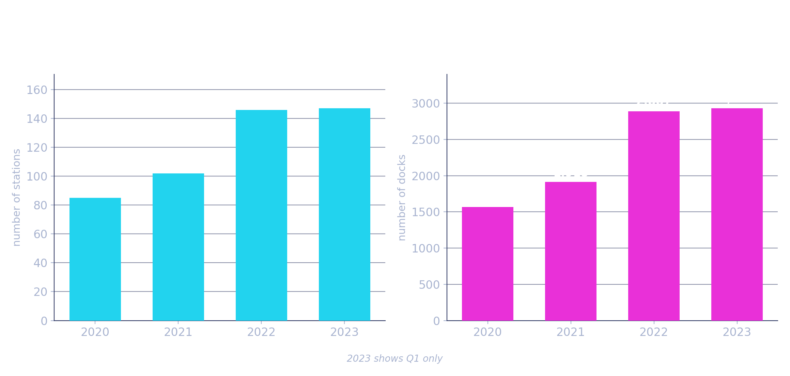

GIRA
Overview
Cleaning
Analysis
Dashboard
Page 08
ANALYTICS.
PART 3 · ANALYSIS
Stations nearly doubled, capacity grew faster
TAKEAWAYS
85 → 102 → 146 → 147
active stations, 2020 → 2023 Q1
2021 → 2022 capacity grew faster than station count
newer stations were built larger, not just more numerous
2023 is Q1 only, so always compare like-for-like quarters
Notes:
Network roughly doubled: 85 to 147 stations. The more interesting detail is 2021 to 2022 - capacity grew FASTER than station count, meaning newer stations were built bigger. Caveat to state out loud: 2023 is Q1 only, so we always compare like-for-like quarters.

Slide 9
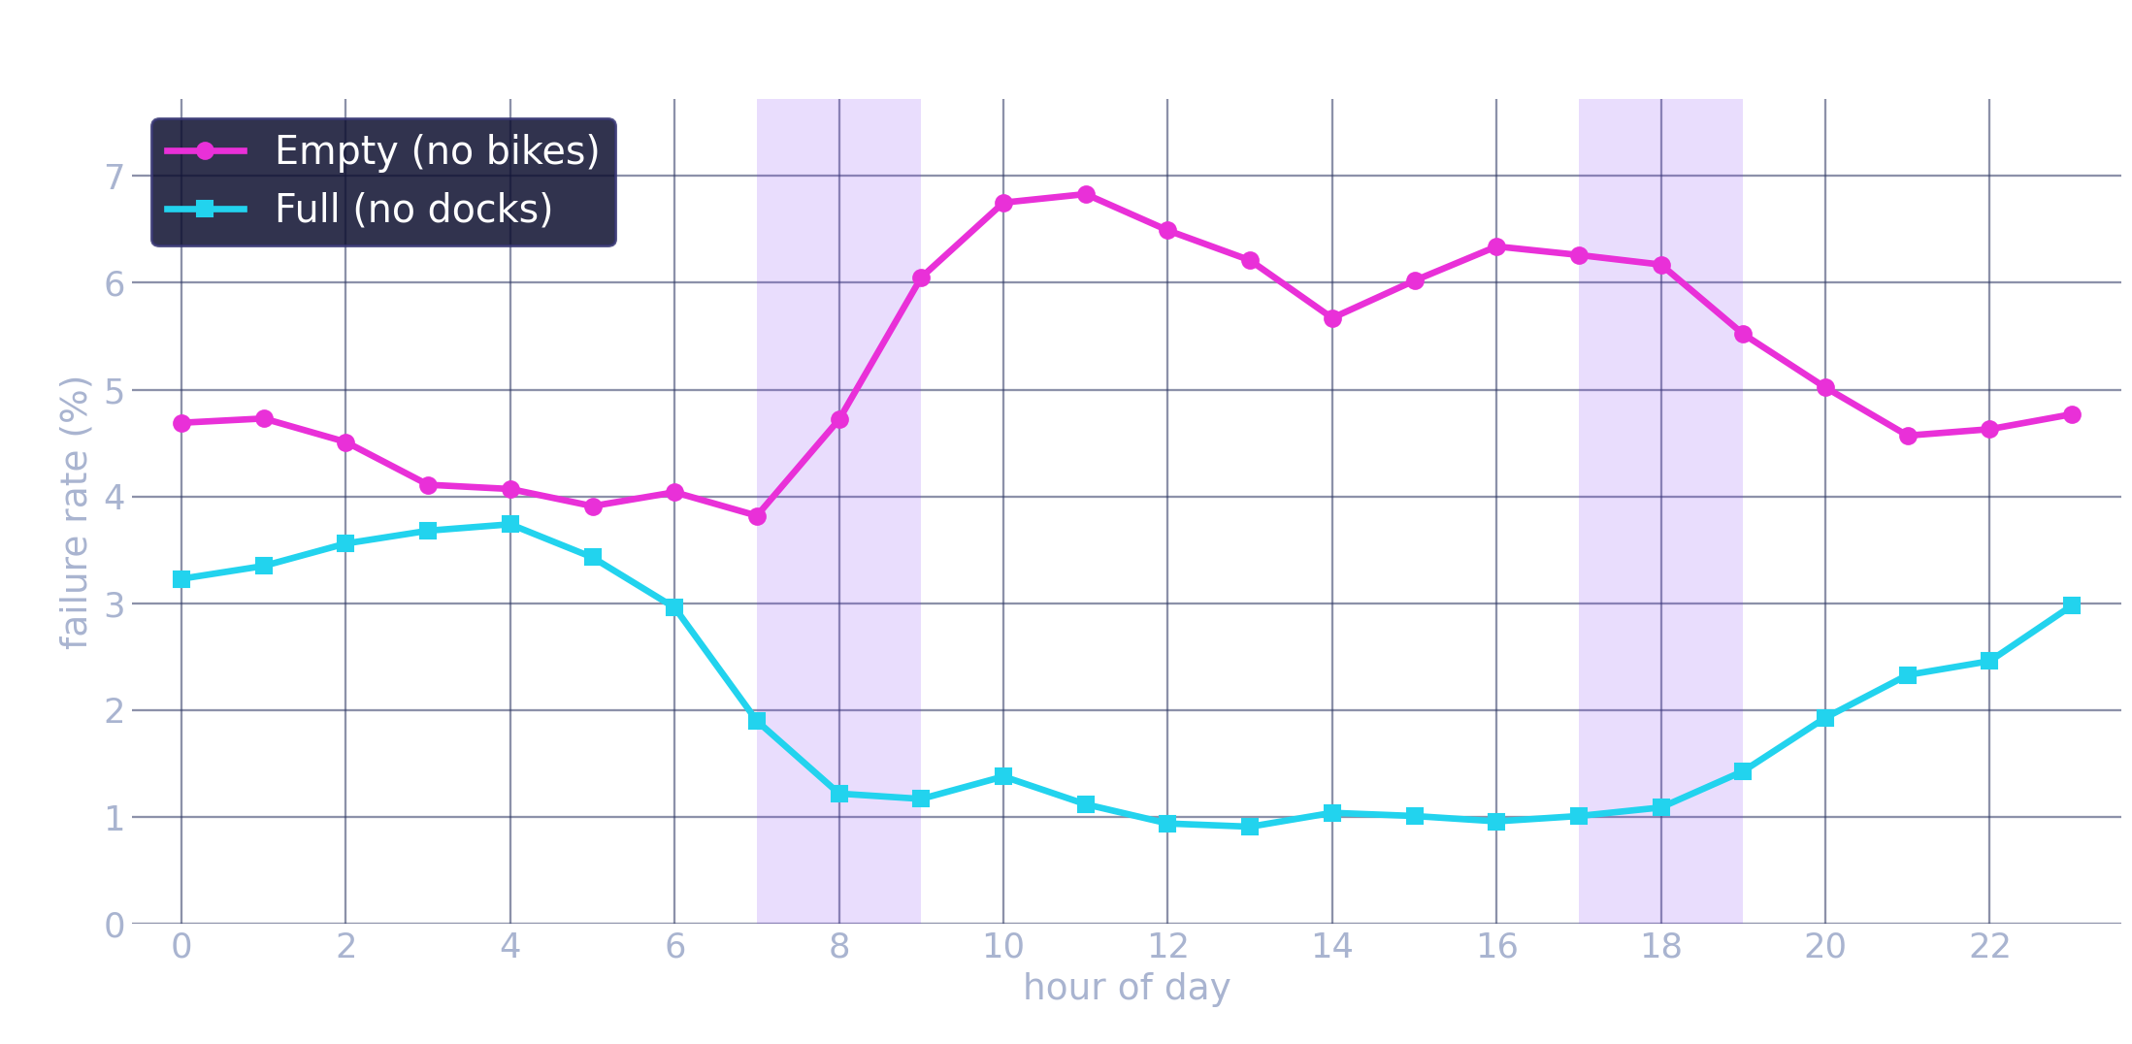
GIRA
Overview
Cleaning
Analysis
Dashboard
Page 09
ANALYTICS.
SQ1 · WHEN DOES IT FAIL?
Empty peaks mid-morning; full peaks overnight
TAKEAWAYS
Empty bottoms at 3.8% at 07:00, then a 6.2–6.8% plateau from 10:00 to 18:00
Full is the mirror image: ~3.7% before dawn, under 1% by midday
The two peak at opposite hours: bikes drain out by day and dock back up overnight
Repair and impossible rows excluded; local time throughout
Notes:
Read the shape, not the individual numbers. Empty rate is low overnight, climbs sharply from 07:00, holds a plateau around 6.8% through midday. Full rate does the exact opposite. They are mirror images. Interpretation: bikes drain out of some stations during the day and pile back up overnight. That is a distribution problem, not a fleet-size problem.

Slide 10
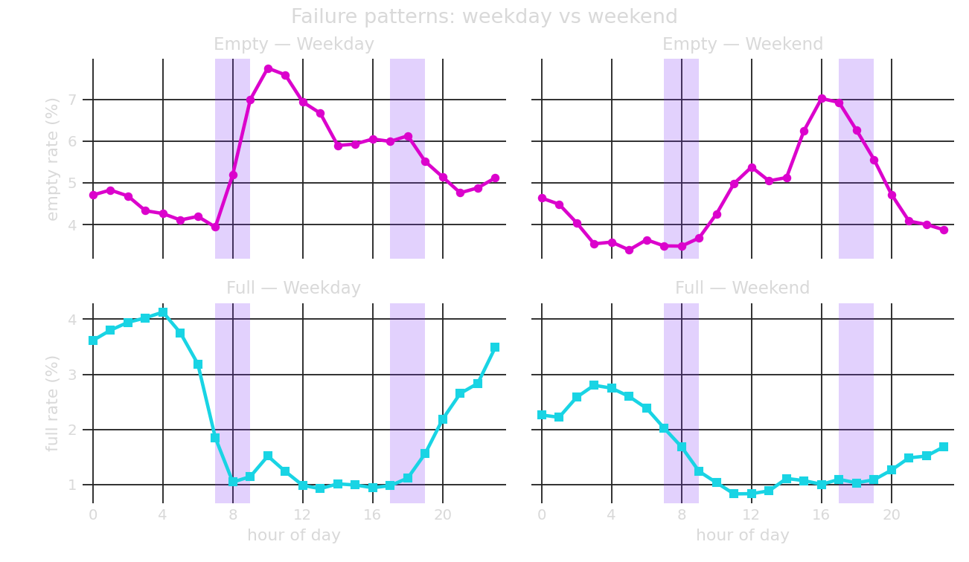
GIRA
Overview
Cleaning
Analysis
Dashboard
Page 10
ANALYTICS.
SQ1 · WHEN DOES IT FAIL?
A commuter fingerprint: weekday 10:00 vs weekend 16:00
TAKEAWAYS
Weekday empty peak: 10:00, at 7.7%
Weekend empty peak: 16:00, at 7.0%, a full six hours later
Weekdays swing harder (3.9–7.7%) than weekends (3.4–7.0%)
That is the commuter mechanism: sharp weekday morning peak, gentler and later leisure pattern at weekends
Notes:
This slide proves the mechanism. If failures were random, weekday and weekend would look the same. They don't. Weekday empty peaks at 10:00; weekend peaks at 16:00 - six hours later. Weekdays also swing harder. The later flatter weekend curve is leisure; the sharp weekday spike is commuting. The network fails in a predictable, schedulable way - which is what makes it fixable.

Slide 11
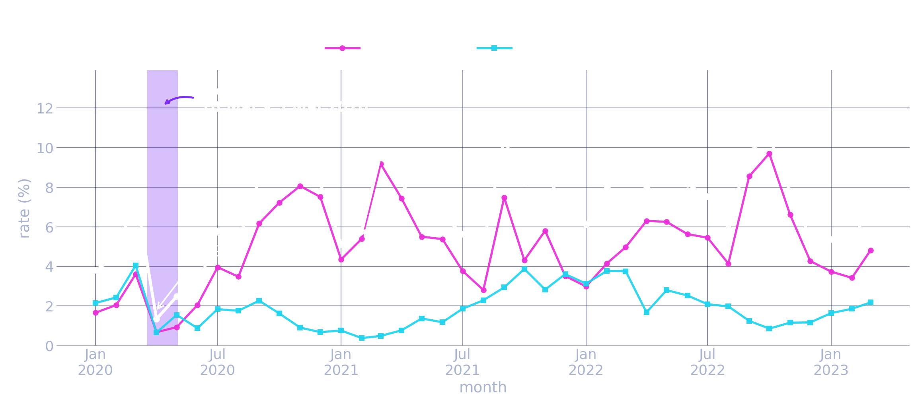
GIRA
Overview
Cleaning
Analysis
Dashboard
Page 11
ANALYTICS.
SQ1 · WHEN DOES IT FAIL?
Lockdown “fixed” availability by removing riders
TAKEAWAYS
April 2020 fell to 1.3%, the lowest month in the whole series
Nobody was riding, so bikes stayed docked. Availability looked perfect because demand had vanished
The effect lasted about four months. By September 2020 failures hit 8.4%, above the pre-lockdown 3.8–4.5%
So, failure rate tracks demand, not network health: the rise through 2021–22 is partly a busier network
Notes:
Guided exercise question 15. The lockdown window is the real Portuguese state of emergency, 18 March to 3 May 2020, which is why the band does not align neatly with calendar months. Read the shape: January and February 2020 sit at 3.8 and 4.5 per cent, March spikes to 7.7, then April collapses to 1.3 per cent, the lowest month in the entire four years. The interpretation matters more than the number. Availability was not good during lockdown because the system was working well; it was good because almost nobody was riding, so every bike stayed docked. Be ready for the March question: March 2020 looks high because lockdown was declared on the 18th, so the month mixes two very different halves. On duration: recovery took roughly four months, and by September 2020 the failure rate was 8.4 per cent, comfortably above pre-lockdown. The wider lesson, and the strongest thing to say here, is that failure rate is a demand signal as much as a service signal, so the upward drift through 2021 and 2022 partly reflects a busier, better-used network rather than a degrading one. One caveat to have ready if challenged on the trend: 2020 has no estado column, so no 2020 row can be flagged as under repair. Maintenance snapshots stay in the 2020 denominator and are removed from 2022 and 2023, which makes 2020 look marginally better than the years it is compared against. The notebook measures this - at most 0.37 percentage points - so the slope is very slightly overstated, but nowhere near enough to change the reading.

Slide 12
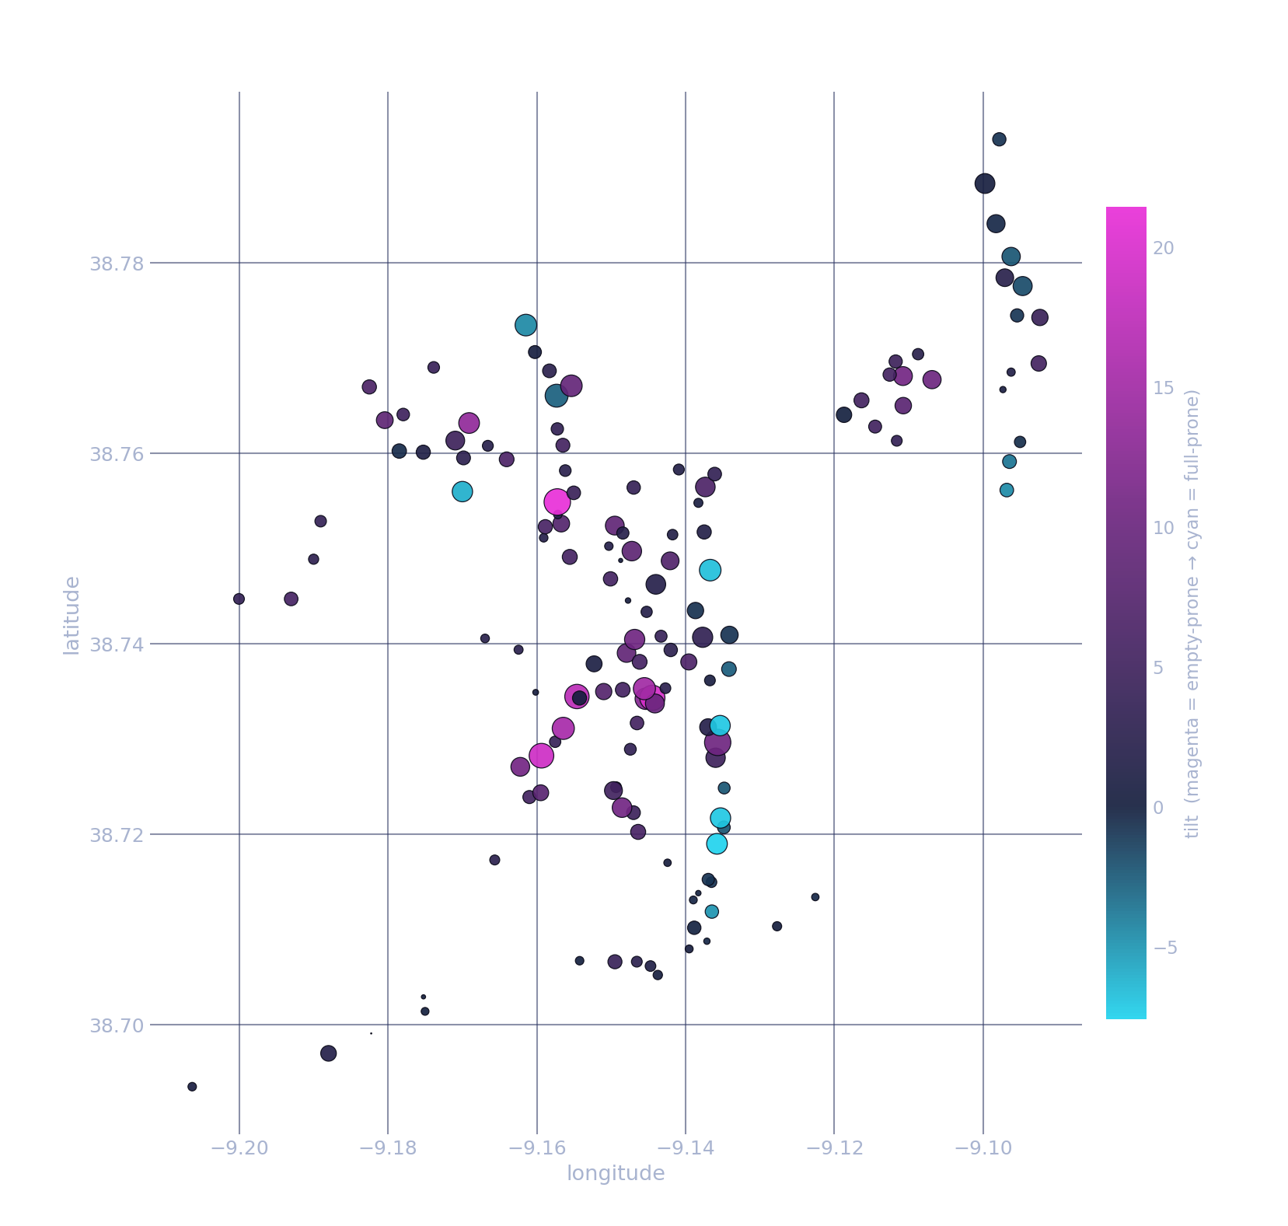
GIRA
Overview
Cleaning
Analysis
Dashboard
Page 13
ANALYTICS.
SQ2 · WHERE DOES IT FAIL, AND WHY?
Lisbon's hills write the failure map
TAKEAWAYS
0.39
81m vs 30m
tilt vs real elevation (latitude proxy managed only 0.06)
median elevation: empty-prone vs full-prone stations
Real elevation, joined per station from an open elevation API, is a far stronger signal than latitude. This is about altitude, not north/south
Empty-prone stations sit uphill (magenta); full-prone sit by the river and downtown (cyan). Riders coast down and avoid the ride back up
Worst empty: 479 – Rua Prof. Oliveira Marques, empty 21.9% of the time (~84m)
Worst full: 452 – Rua Teixeira de Pascoais / Dr. Gama Barros, full 10.8%
Notes:
The strongest finding. First we tested the hills hypothesis using latitude as a rough proxy and got almost nothing - 0.06. Then we joined real elevation per station from the Open-Meteo API and the correlation jumped to 0.39. Median elevation of empty-prone stations is 81m versus 30m for full-prone. People ride downhill to the river and don't ride back up. If asked why it isn't higher: elevation is one driver among several - transit hubs and land use matter too.

Slide 13


GIRA
Overview
Cleaning
Analysis
Dashboard
Page 14
ANALYTICS.
SQ2 · INTERACTIVE MAP
Explore the failure map, station by station
The same geography finding, built as a Leaflet map you can pan, zoom and click.
141 stations
Colour = tilt
Size = severity
Every station with enough data, plotted on the real city map.
Red runs empty, blue runs full, on a –15 to +15 scale.
Bigger circle, higher combined empty + full rate.
Click any station and the popup gives its elevation, empty rate, full rate and dominant failure type.
▶ Open the interactive map
Notes:
Open the HTML map in a browser here. It is a Folium / Leaflet map, standalone, so it needs no server. Point out that it is the interactive twin of the scatter on the previous slide: same tilt colour scale from -15 to +15, red for empty-prone and blue for full-prone, with circle size showing severity, the combined empty and full rate. The advantage over the static chart is that the audience can see the real street map underneath, so the hills and the riverside are recognisable as actual Lisbon rather than as dots on axes. Good live move: zoom to the riverside and show the blue cluster, then pan uphill to the red ones. Note the map plots the 141 stations with enough snapshots to be reliable; six thin ones are excluded. Click station 479 to show the worst empty station and its elevation in the popup.

Slide 14
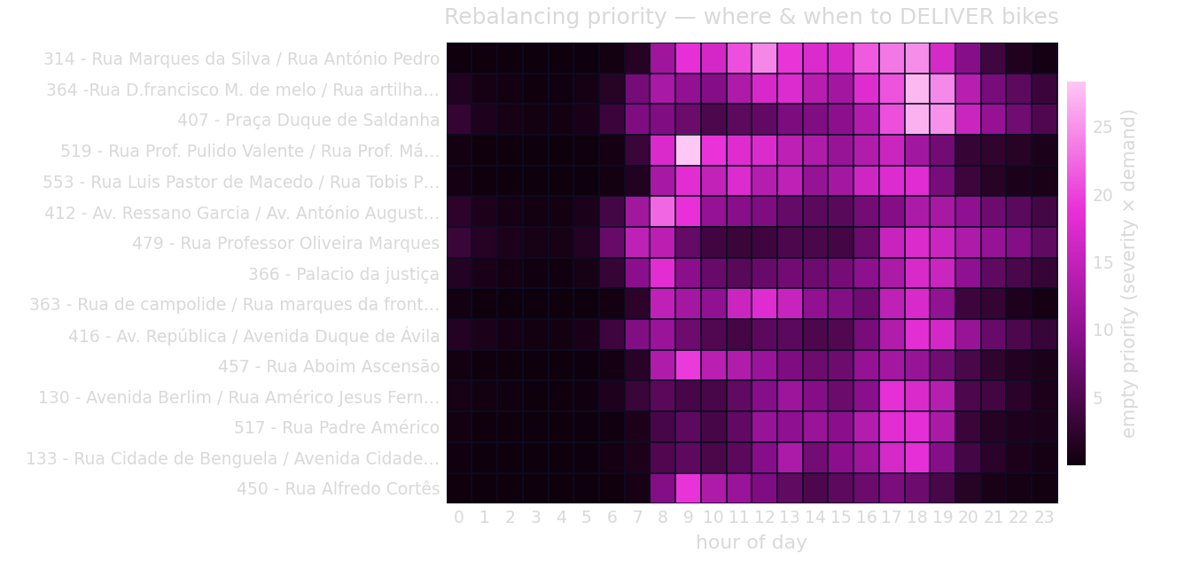
GIRA
Overview
Cleaning
Analysis
Dashboard
Page 15
ANALYTICS.
SQ3 · WHAT SHOULD EMEL DO FIRST?
The priority list: where and when to deliver bikes
TOP PRIORITY
519
Rua Prof. Pulido Valente, 09:00, 33.3% empty
Priority = failure severity × a commute-shaped demand curve. The curve is fixed, not data-derived. Deriving demand from the same data would be circular with the failure rate itself.
Notes:
This is the actual client deliverable - it answers 'where do I send the van first?' Explain the priority score: failure rate alone is misleading, because a station empty at 04:00 harms almost nobody. So we weight severity by rider demand at that hour. Important: we used a FIXED commute-shaped demand curve rather than deriving demand from the data, because deriving it from the same dataset would be circular. Top of the list: station 519 at 09:00, empty 33.3% of the time.

Slide 15
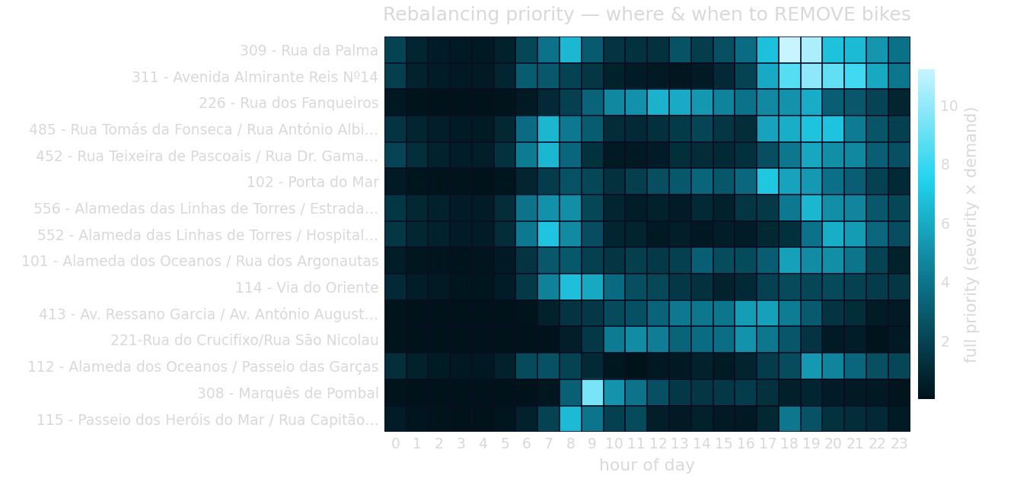
GIRA
Overview
Cleaning
Analysis
Dashboard
Page 16
ANALYTICS.
SQ3 · WHAT SHOULD EMEL DO FIRST?
...and where to collect, paired into short van loops
SAMPLE VAN LOOP
COLLECT
309 – Rua da Palma (18:00, 31 m)
↑ van climbs +48 m ↑
DELIVER
407 – Pça. Duque de Saldanha (18:00, 79 m)
The shortest hop:
COLLECT 552 – Alameda das Linhas de Torres → DELIVER 519 – Pulido Valente
only 1.07 km, +27 m of climb
Each loop moves bikes from a low station that fills up to a higher one that runs dry. The van makes the climb riders won't.
Notes:
The mirror image - stations that fill up and need bikes REMOVED. Then the operationally useful part: pair them. Note carefully that '+48 m' is ELEVATION GAIN, not drive time. Station 309 sits at 31m and overflows; station 407 sits at 79m and runs dry. One van run empties the low station and refills the high one. The 552 to 519 pair is the shortest hop in the list: 1.07 km and 27m of climb. The takeaway: the van makes the climb riders won't. That reframes this as rebalancing, not a reason to buy more bikes. If pushed further, the honest limit of the argument is supply: only 13 stations classify as full-risk against 91 empty-risk, and in the neighbour analysis one station, 316, is the nearest full-risk partner for a third of the worst empty stations. The hops are short, so geography is not the obstacle, but there are not enough naturally-filling stations to draw from. That is the point where rebalancing stops being sufficient and dock sizing starts to matter.

Slide 16
GIRA
Overview
Cleaning
Analysis
Dashboard
Page 18
ANALYTICS.
CONCLUSIONS & RECOMMENDATIONS
What EMEL should do with this
1
Failures are concentrated
2
The failures follow commuters
A handful of stations, at specific hours, drive most empty and full events, not a uniform citywide shortage.
Empty peaks weekday 10:00 and weekend 16:00; full peaks overnight. A clear supply/demand rhythm.
3
Geography is the best predictor
4
Many fixes are cheap
Elevation beats latitude by far (0.39 vs 0.06): uphill runs empty, riverside runs full.
Several worst empty/full pairs are a short van climb apart, so loops beat fleet expansion.
5
Growth outpaced the fix
6
The priority list is ready
Stations went 85→147 and capacity grew faster still, yet 479, 407, 452 and 309 remain problem stations.
The demand-weighted station × hour ranking gives the rebalancing team a daily to-do list.
Notes:
Six conclusions, and the through-line is that the network does NOT fail uniformly. It fails at identifiable stations, at predictable hours, in a direction explained by gravity. Point 5 is the mild criticism of EMEL: capacity grew substantially, yet the same stations remain problem stations - expansion alone did not solve it. Point 6 is the constructive close. If asked for further work: trip-level data, weather, and a proper drive-time matrix would all sharpen the routing.

Slide 17
GIRA
Overview
Cleaning
Analysis
Dashboard
Page 19
ANALYTICS.
Thank You
“The network doesn't fail on average. It fails at specific stations,
at specific hours, downhill by the river, and now we know which ones.”
Python · pandas · cleaning and analysis
Power BI · live dashboard
4,090,179 clean rows · 149 stations
Notes:
Closing line - deliver it slowly, it is the memorable takeaway. Then take questions. If the dashboard demo has not happened yet, this is the natural moment to switch to Power BI and click through the three pages.

